Slide 1
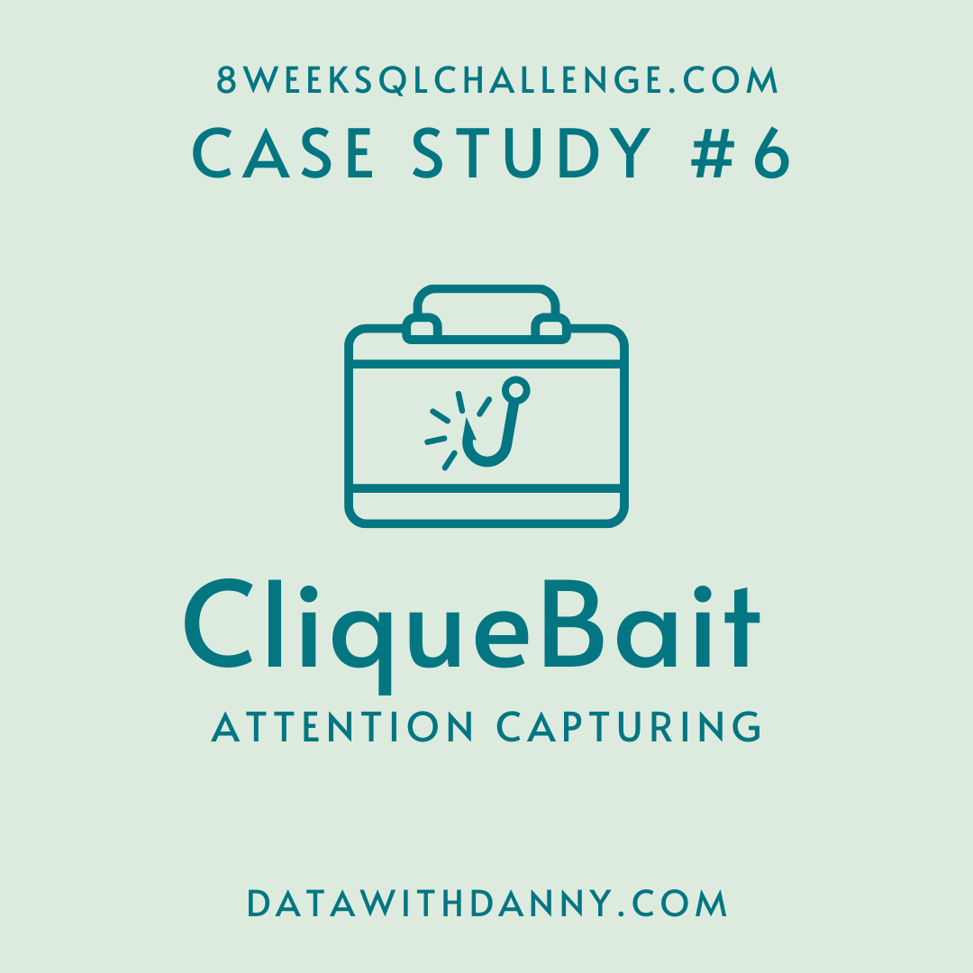
SQL
DATA ANALYSIS PROJECT
Shaik Shoaib Akthar

Slide 2
Introduction
Clique Bait is not like your regular online seafood store - the founder and CEO Danny, was also a part of a digital data analytics team and wanted to expand his knowledge into the seafood industry!
In this case study - you are required to support Danny’s vision and analyze his dataset and come up with creative solutions to calculate funnel fallout rates for the Clique Bait online store.

Slide 3
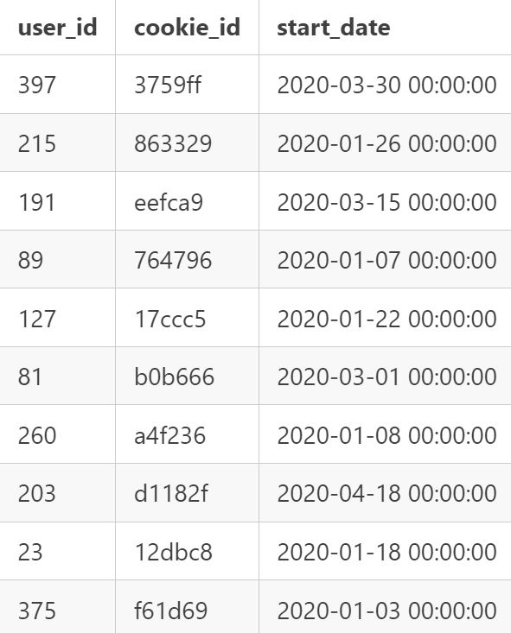
Table 1: Users
Customers who visit the Clique Bait website are tagged via their cookie_id

Slide 4
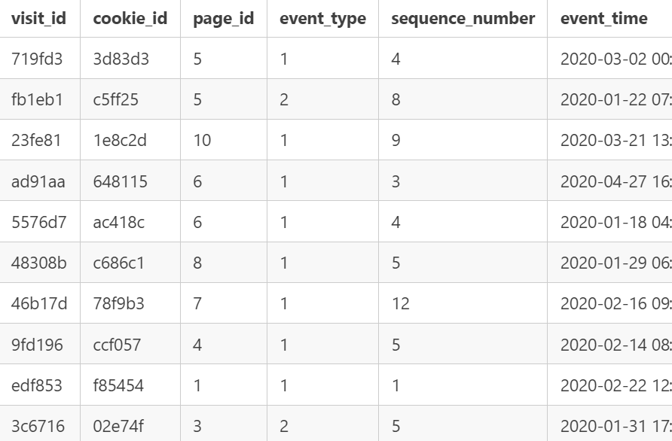
Table 2: Events
Customer visits are logged in this events table at a cookie_id level and the event_type and page_id values can be used to join onto relevant satellite tables to obtain further information about each event.
The sequence_number is used to order the events within each visit.

Slide 5
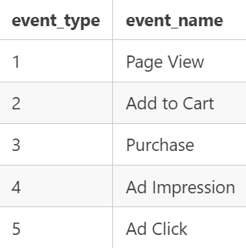
Table 3: Event Identifier
The event_identifier table shows the types of events which are captured by Clique Bait’s digital data systems.

Slide 6
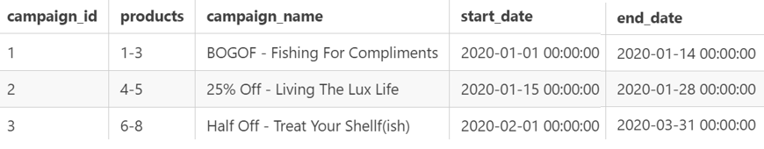
Table 4: Campaign Identifier
This table shows information for the 3 campaigns that Clique Bait has ran on their website so far in 2020.

Slide 7
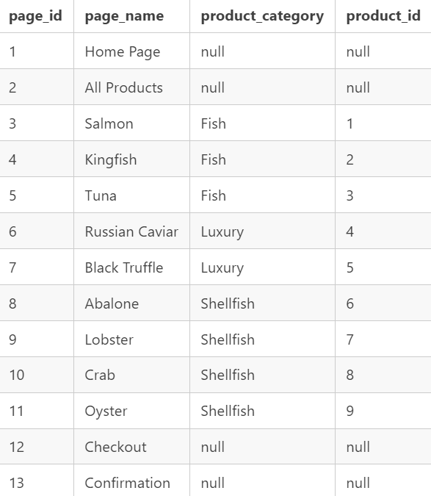
Table 5: Page Hierarchy
This table lists all of the pages on the Clique Bait website which are tagged and have data passing through from user interaction events.

Slide 8
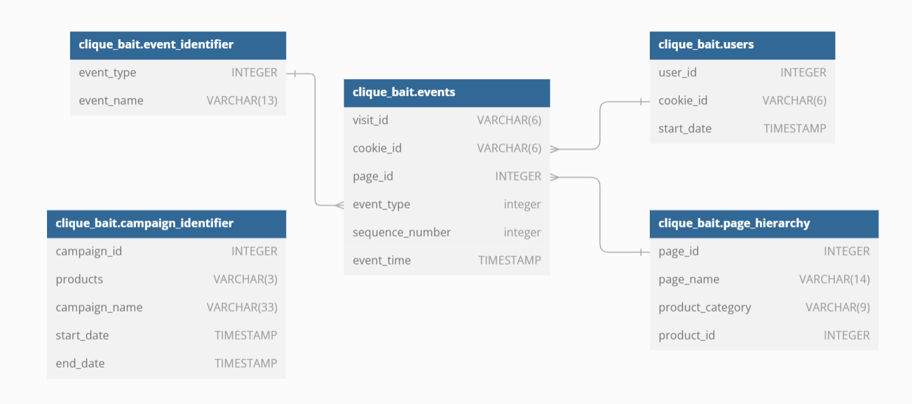
Entity Relationship Diagram

Slide 9
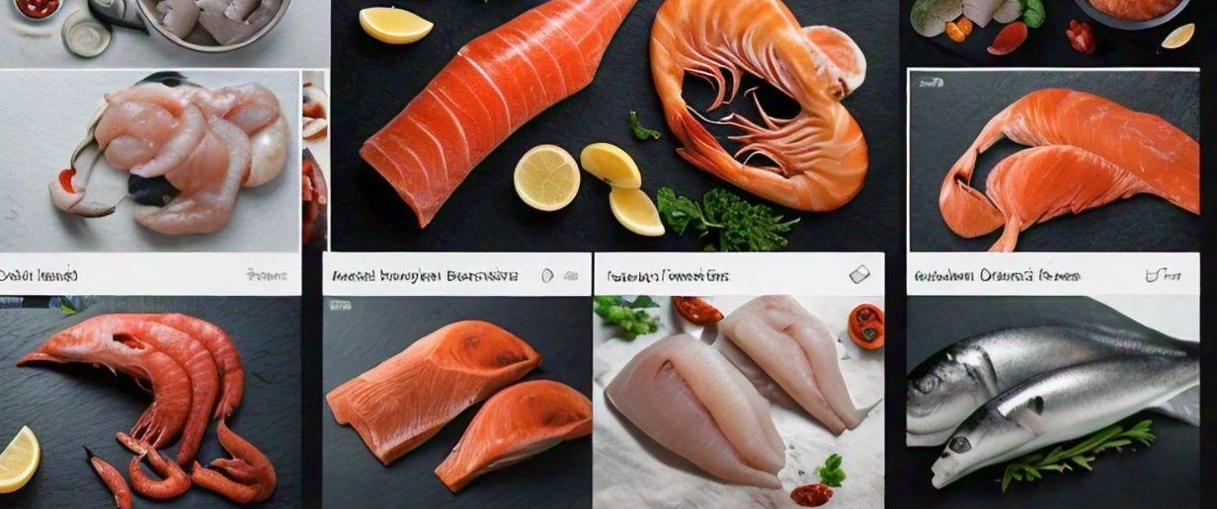
Digital Analysis

Slide 10
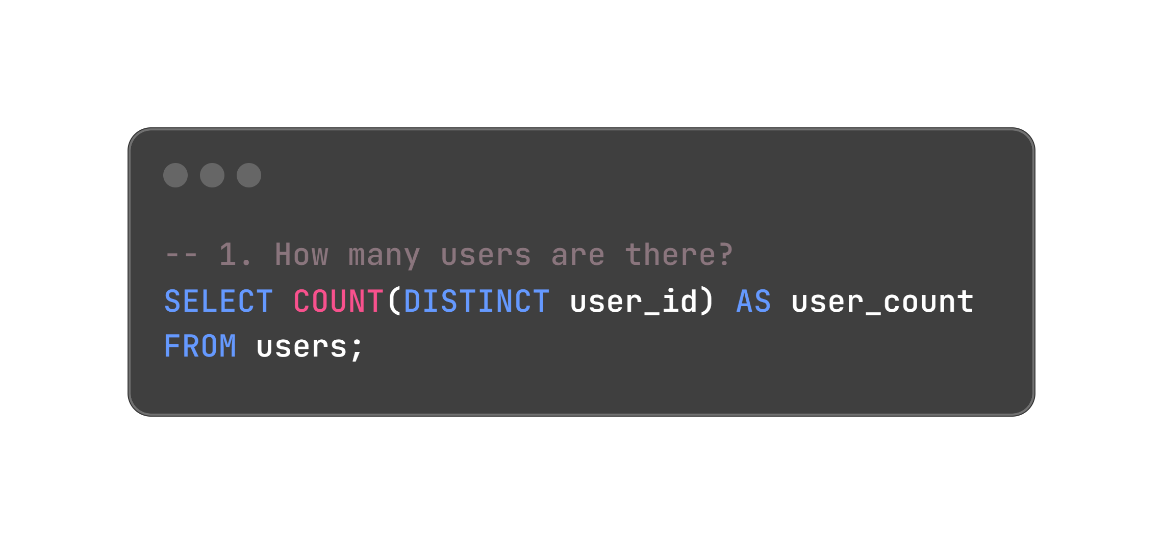
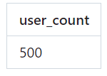

Slide 11
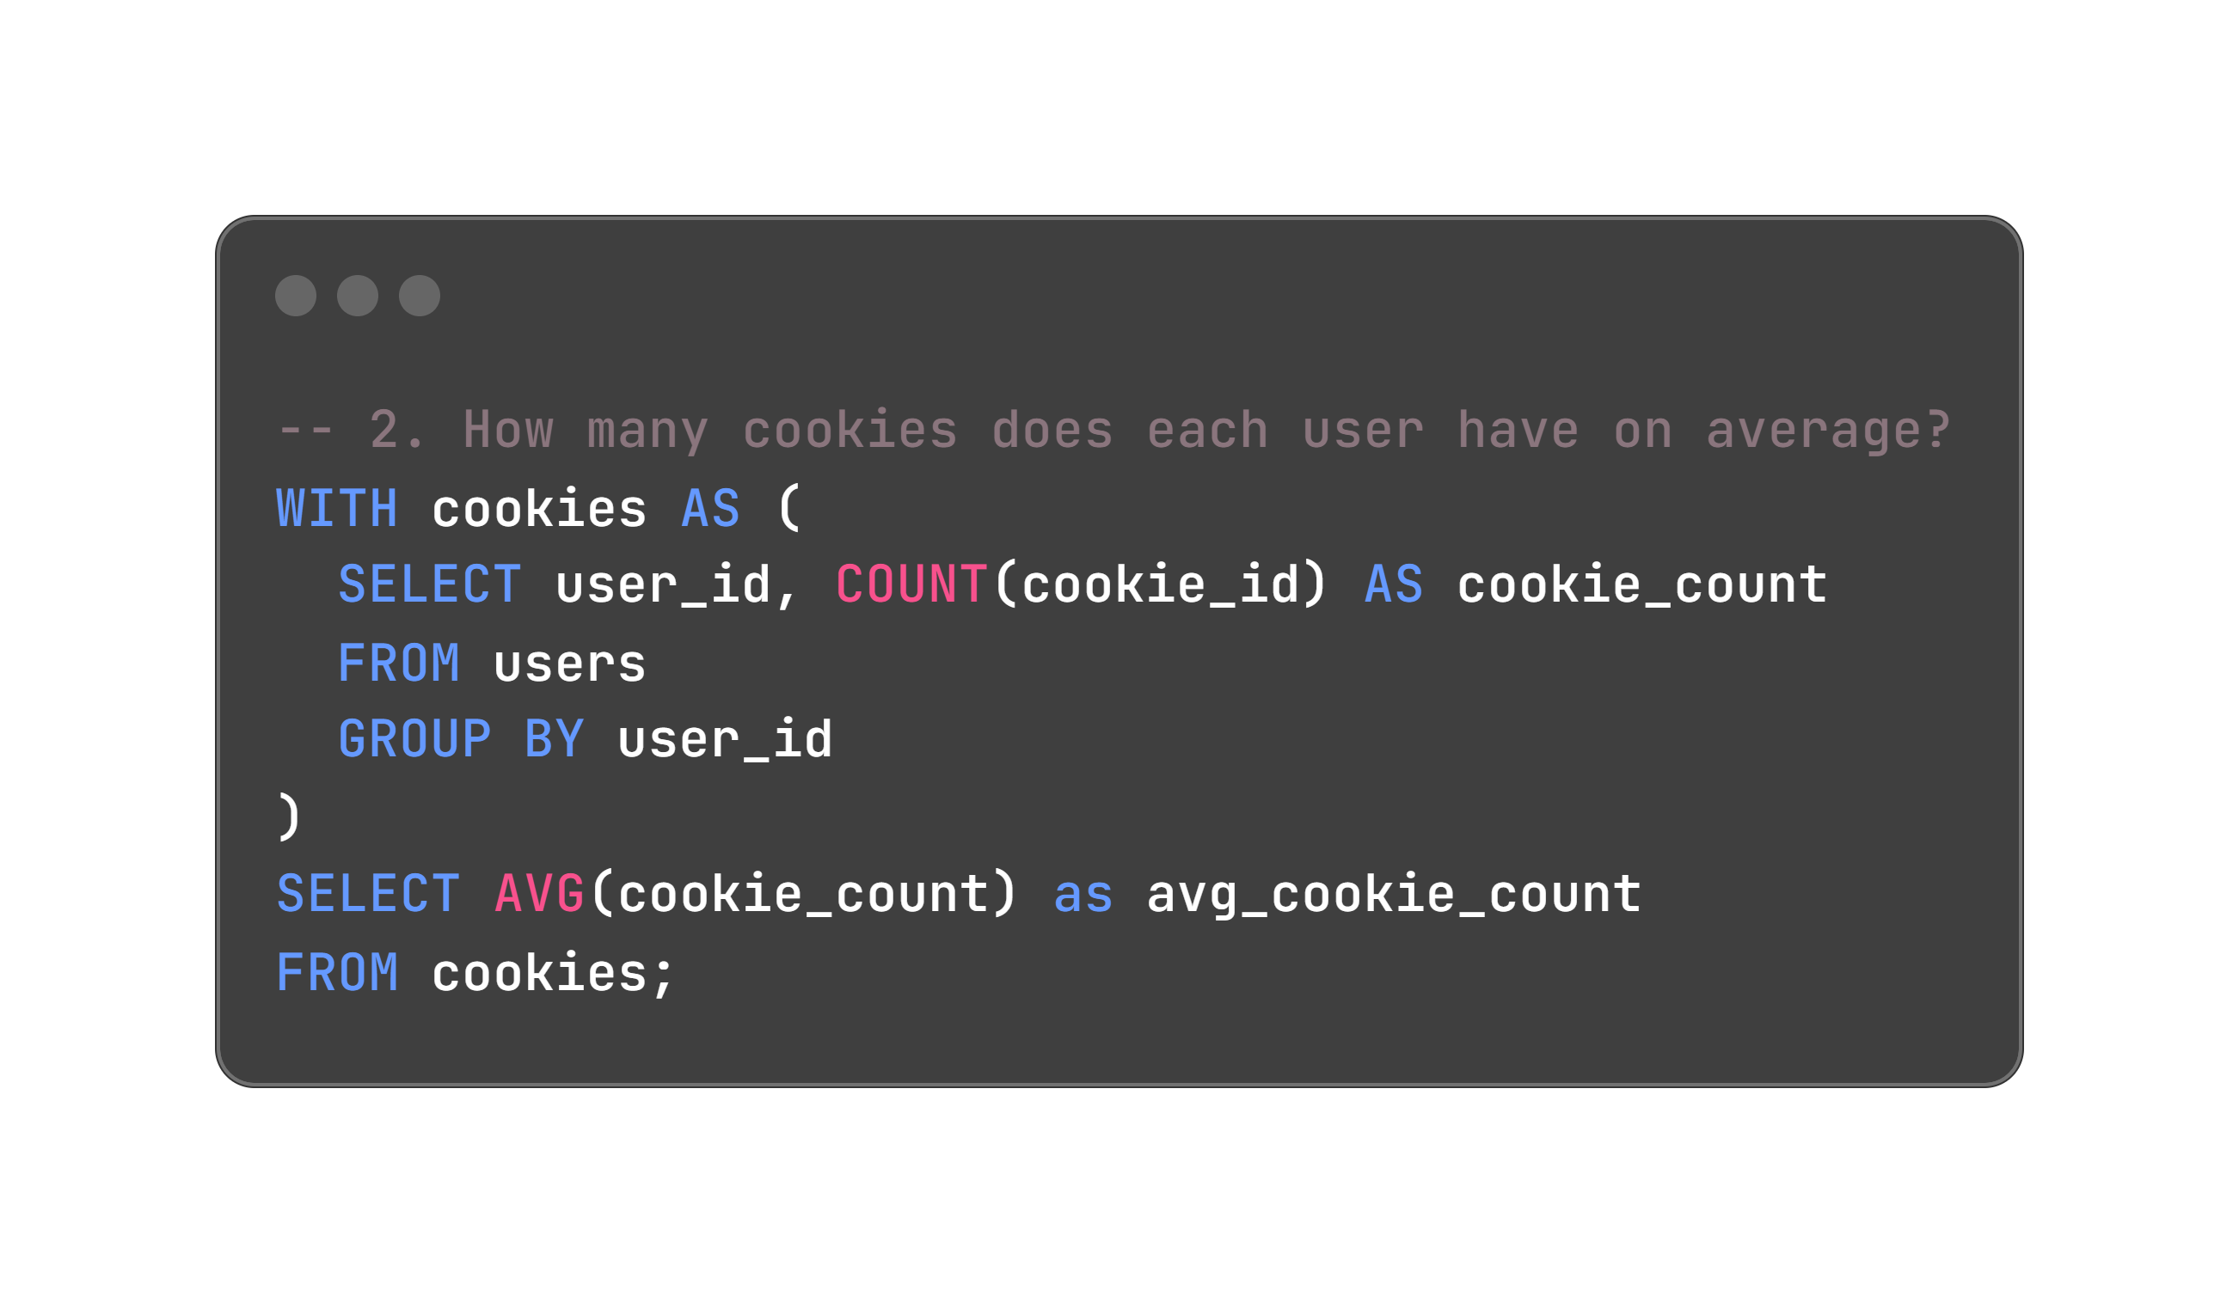
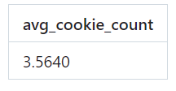

Slide 12
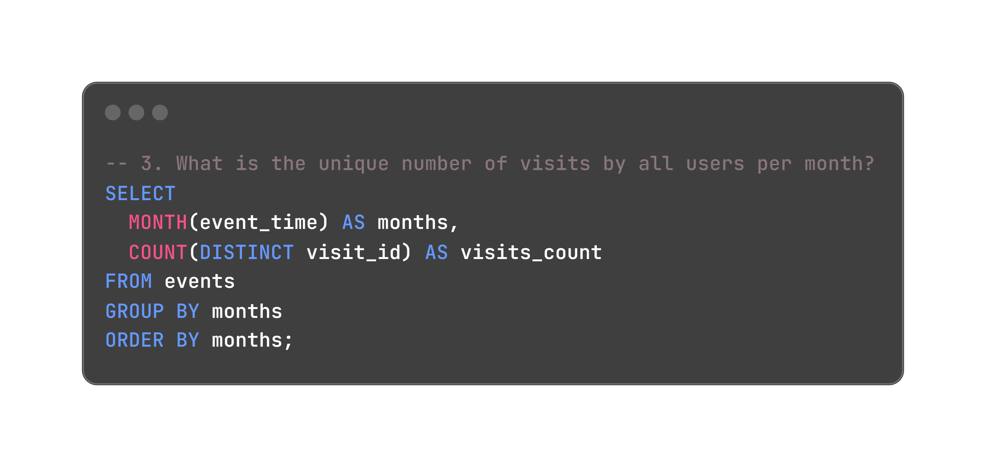
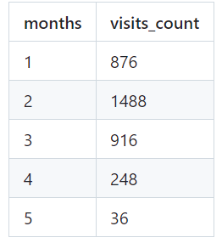

Slide 13
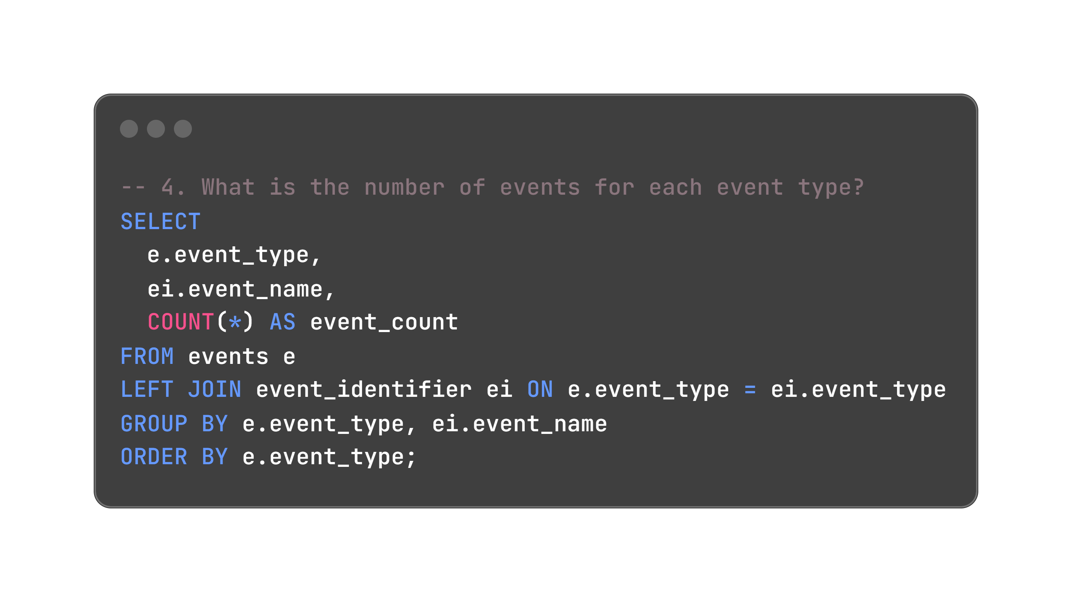
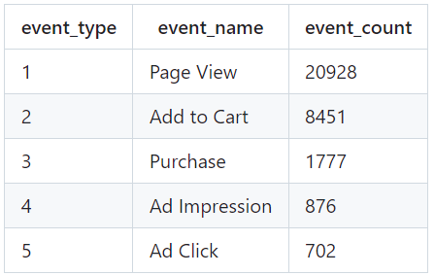

Slide 14
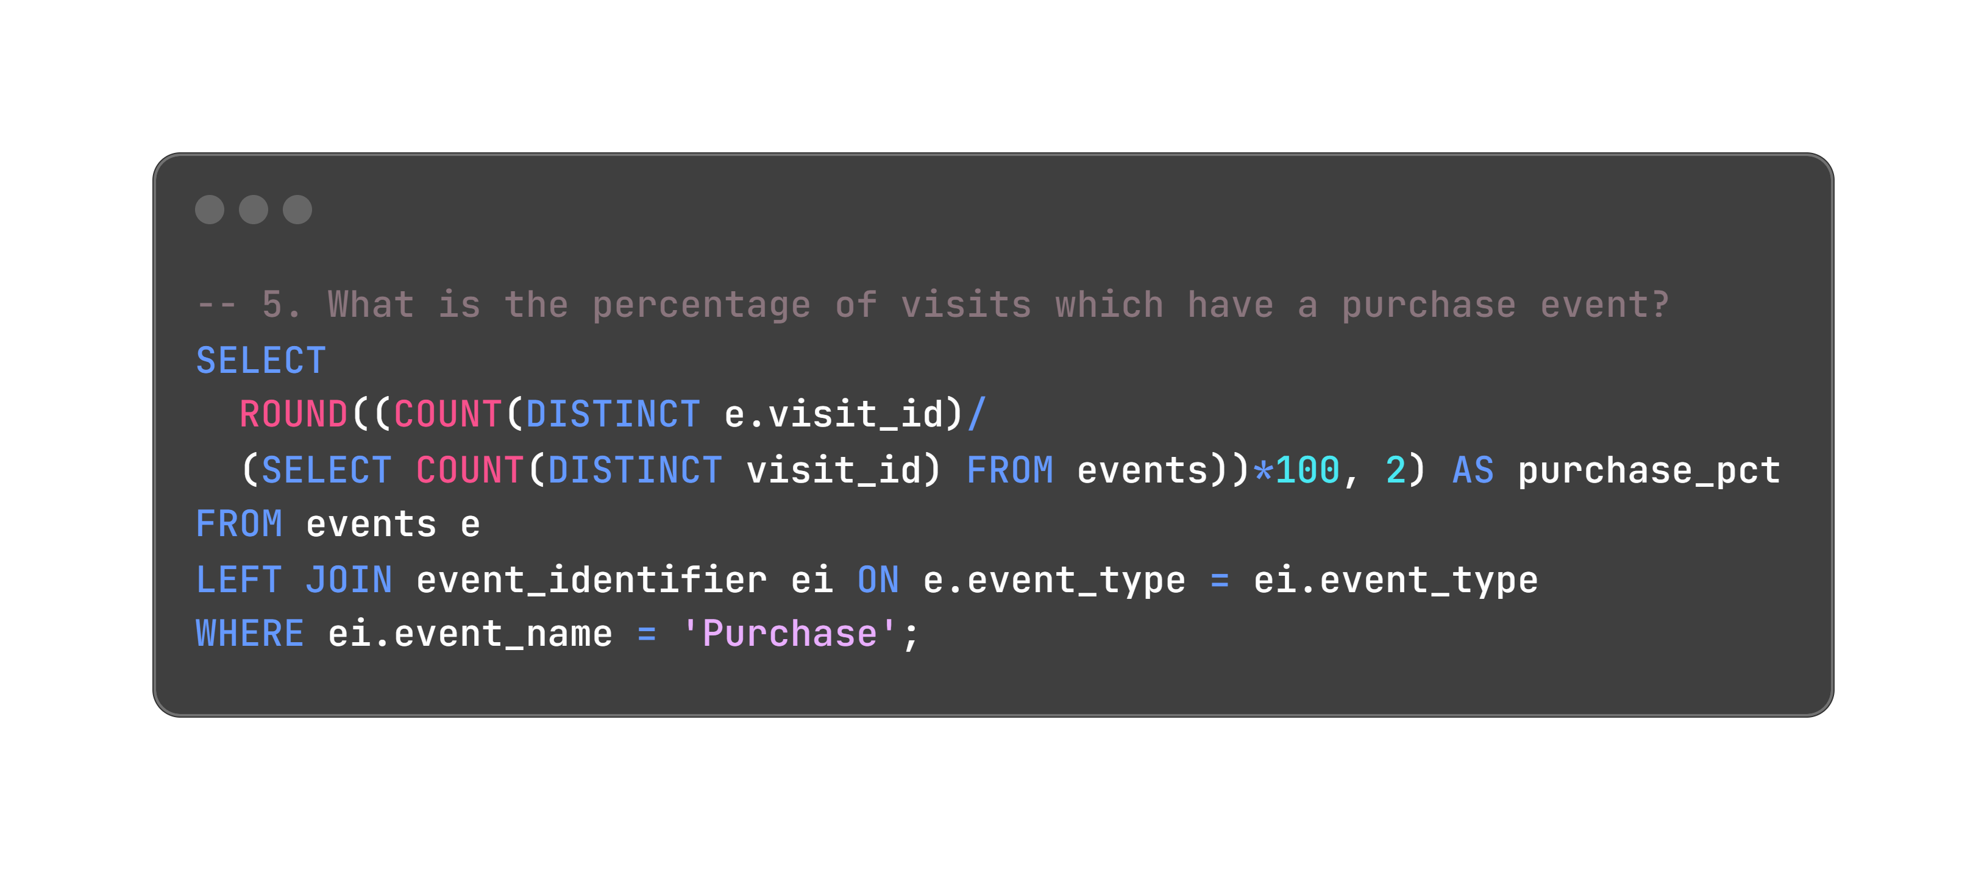
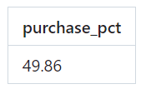

Slide 15
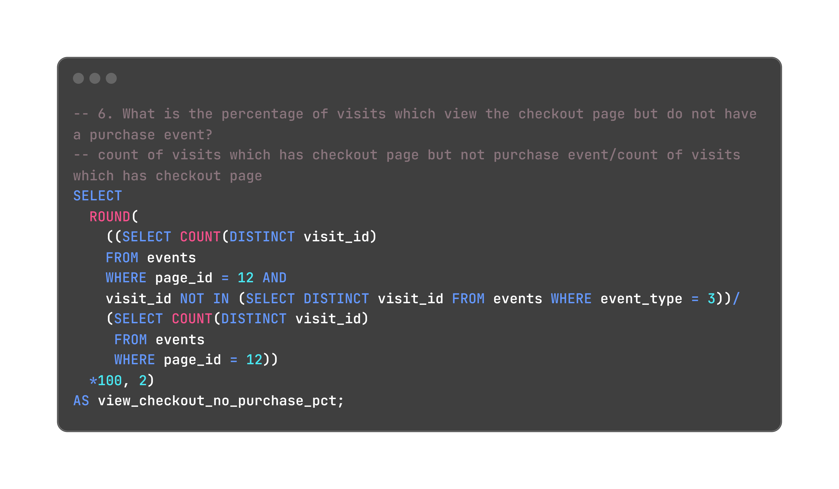
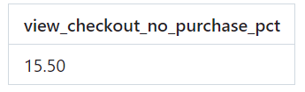

Slide 16
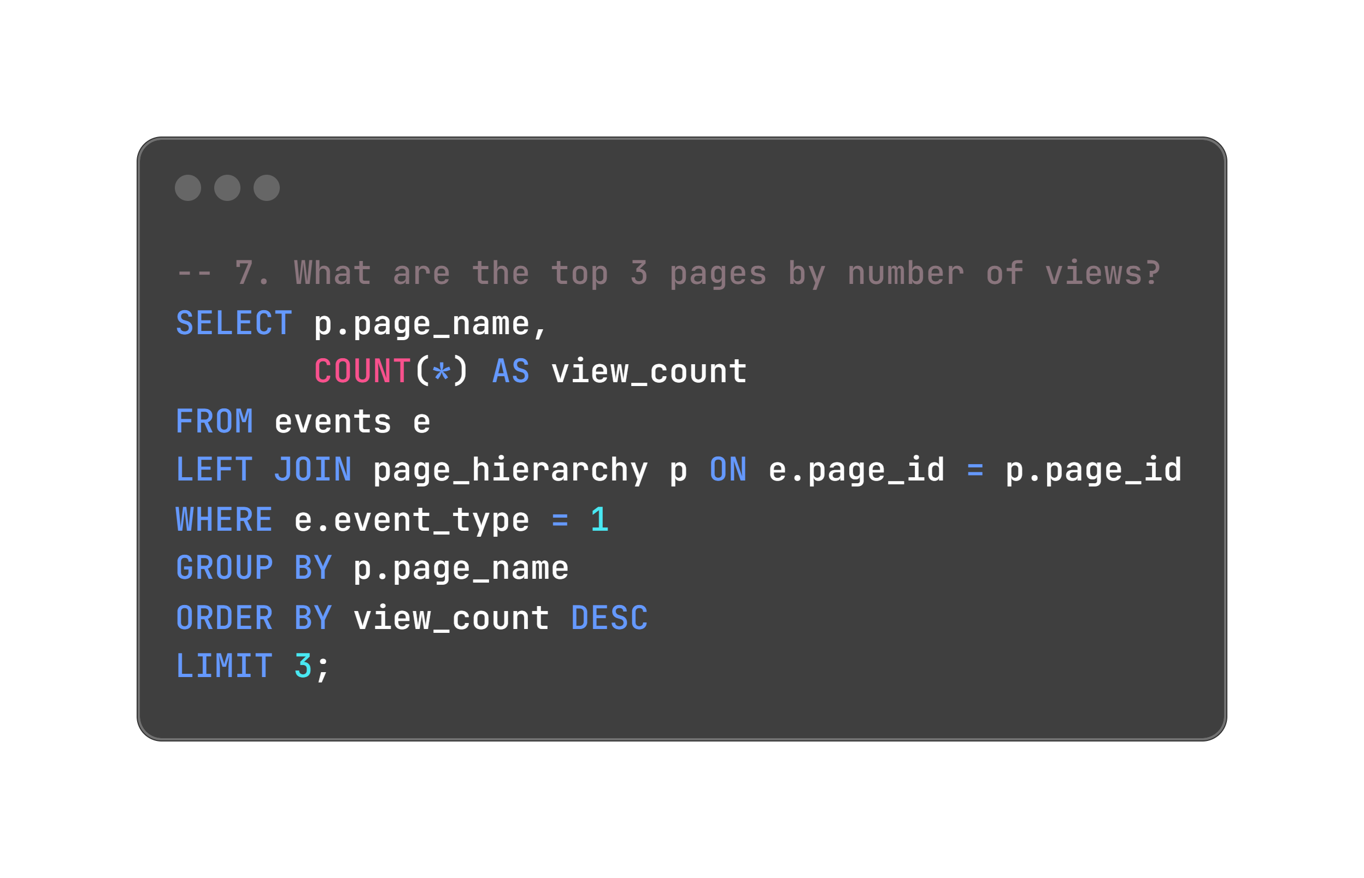
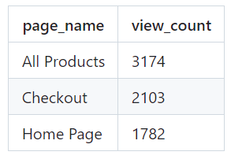

Slide 17
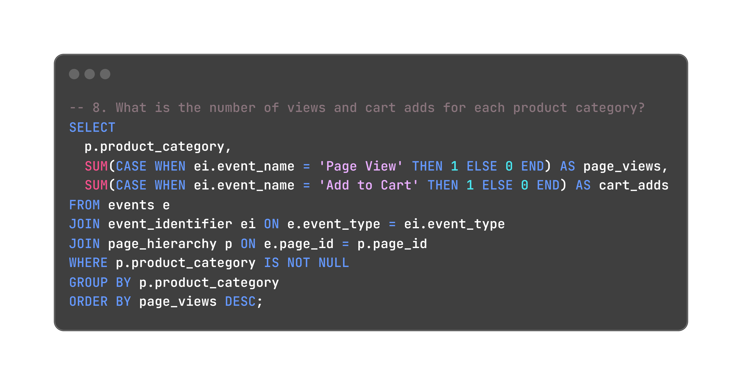
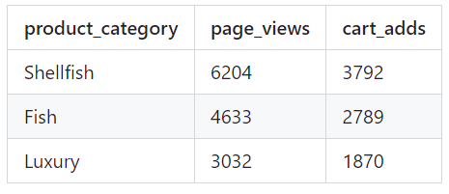

Slide 18
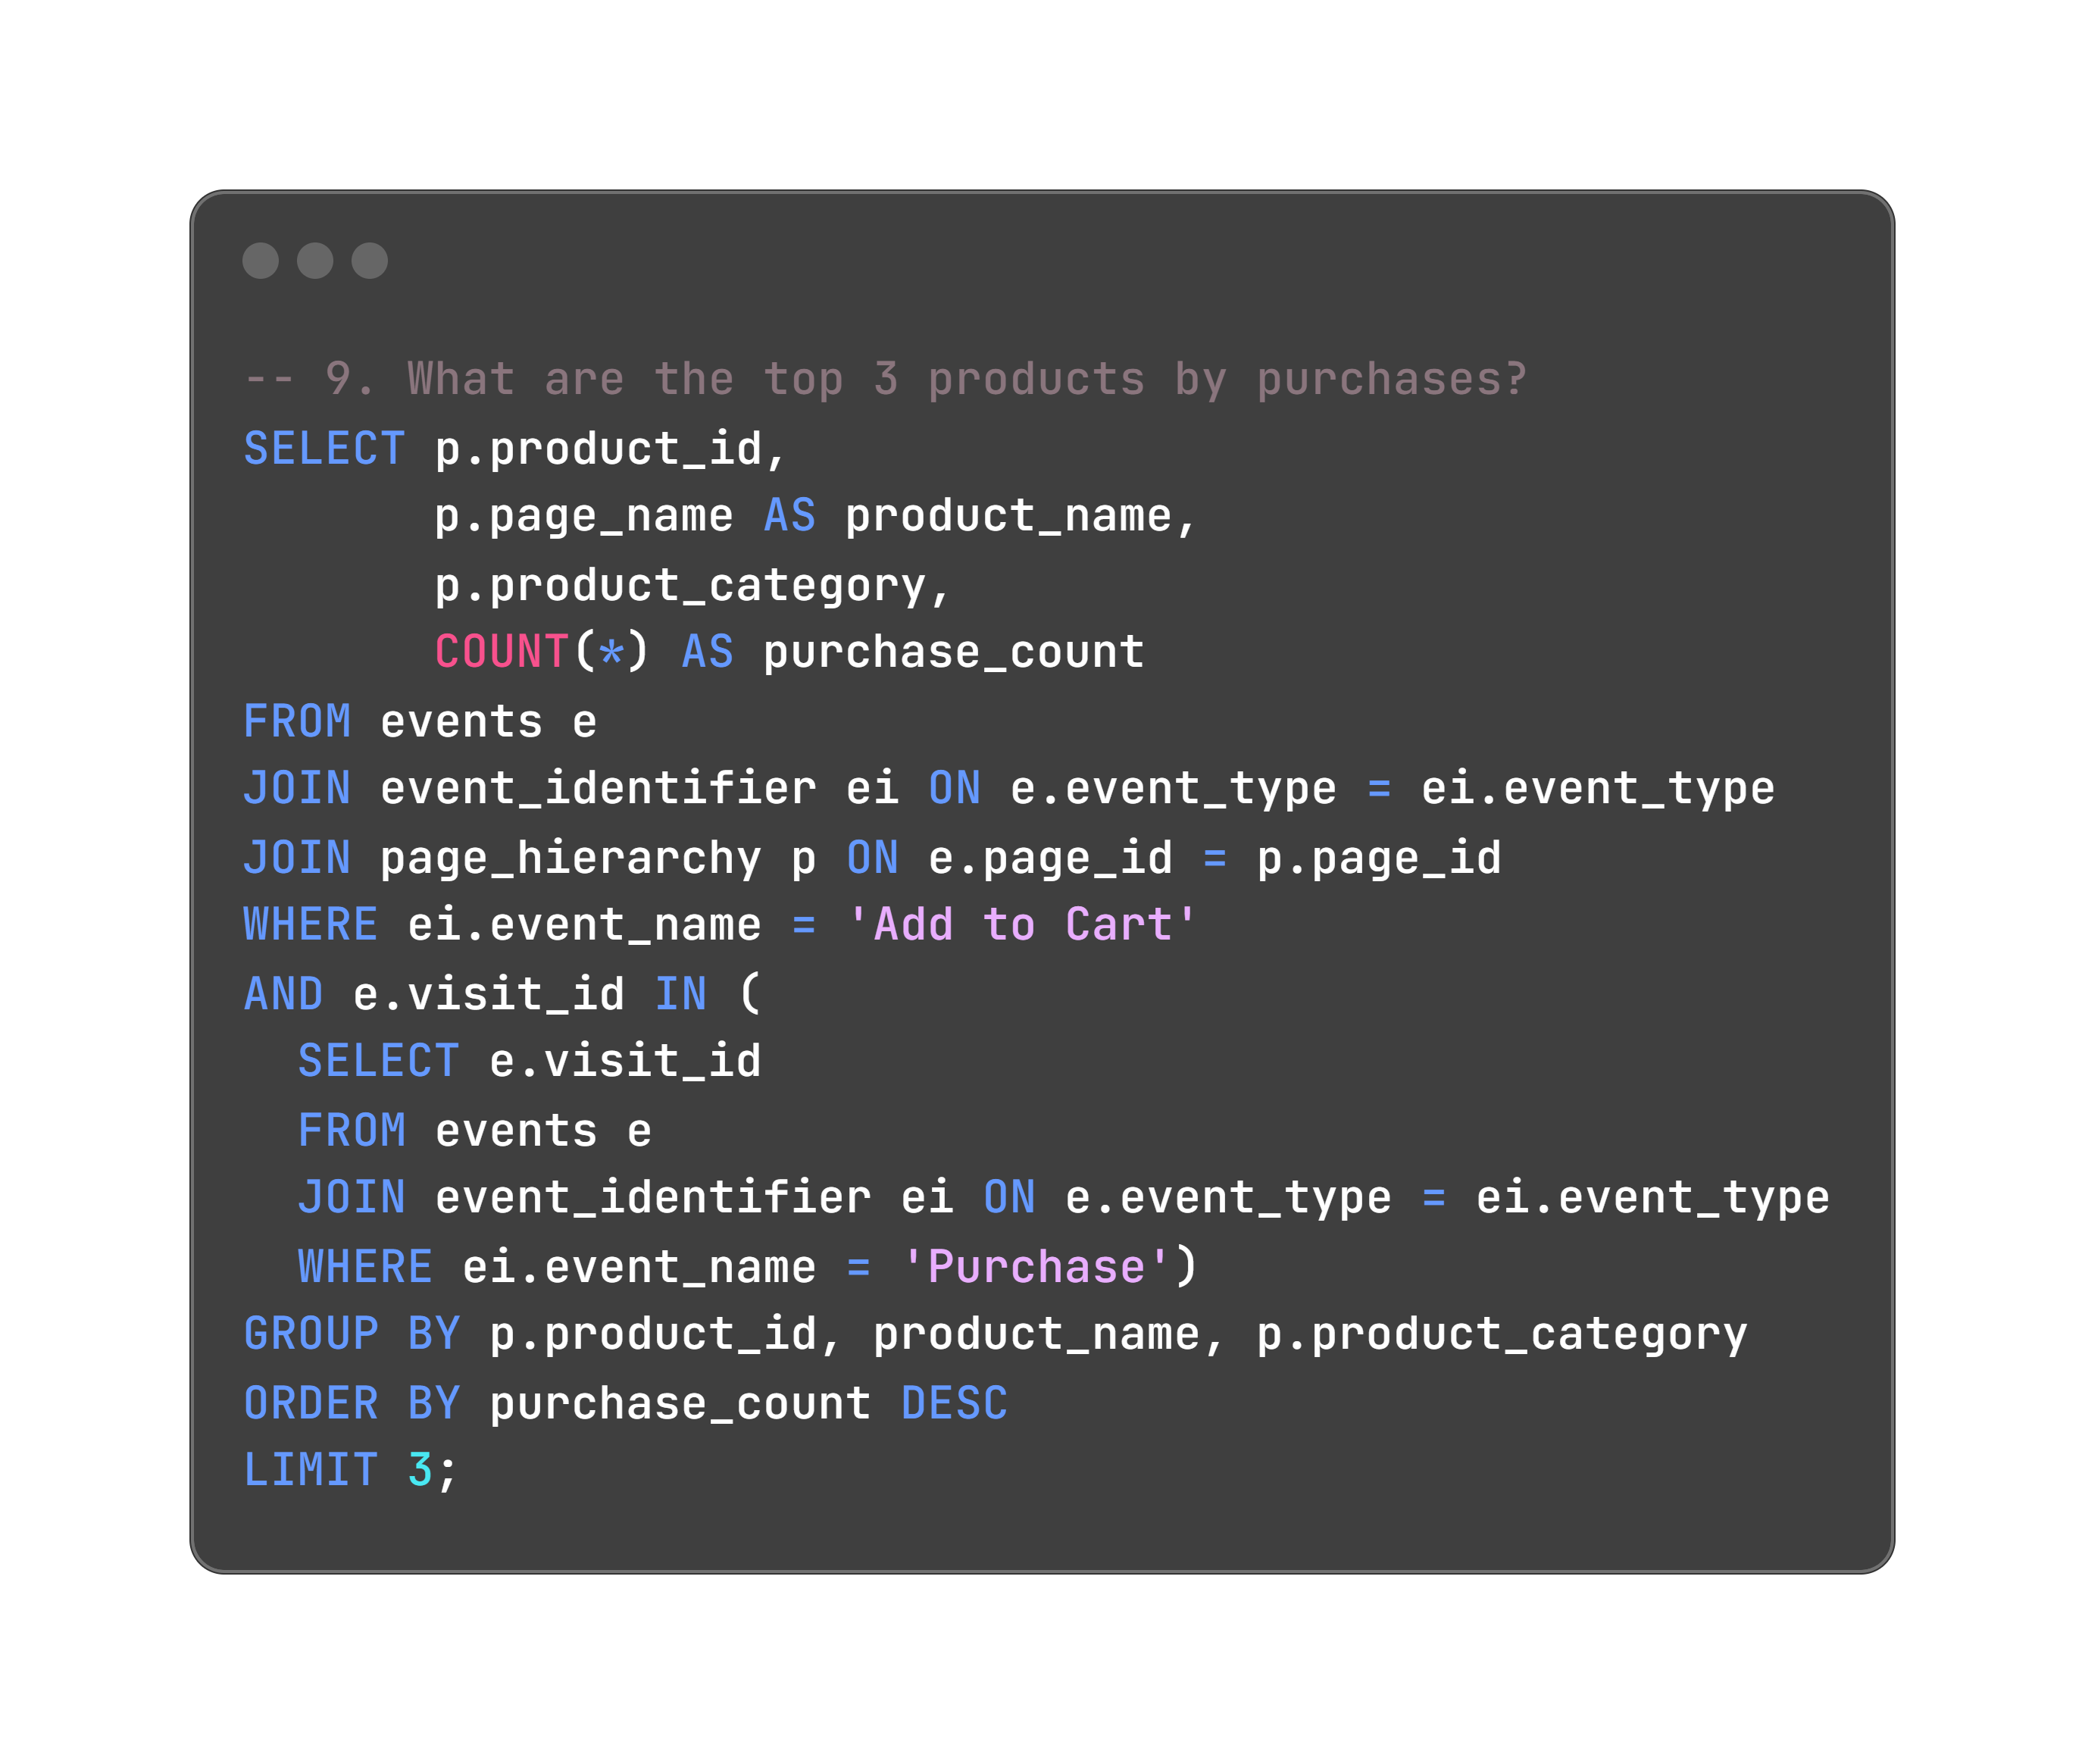
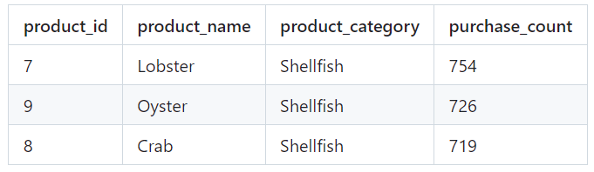

Slide 19
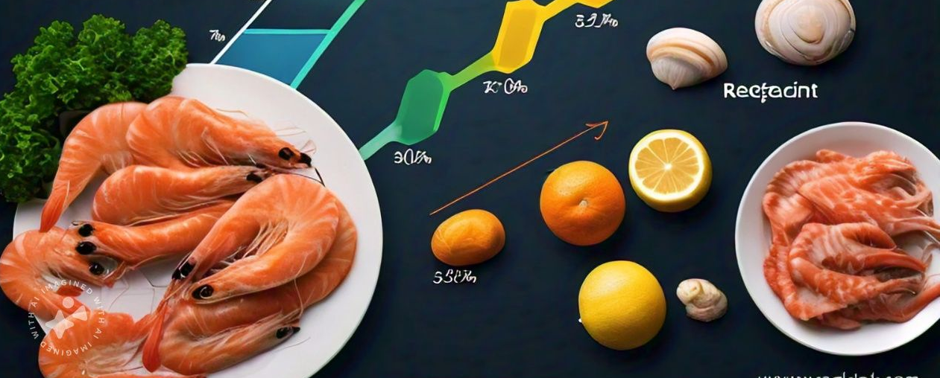
Product Funnel Analysis

Slide 20
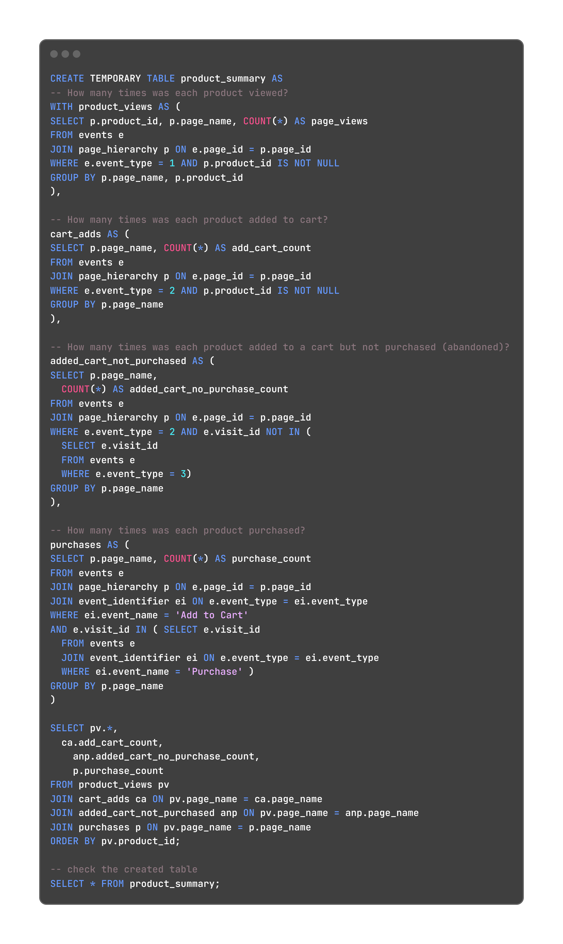
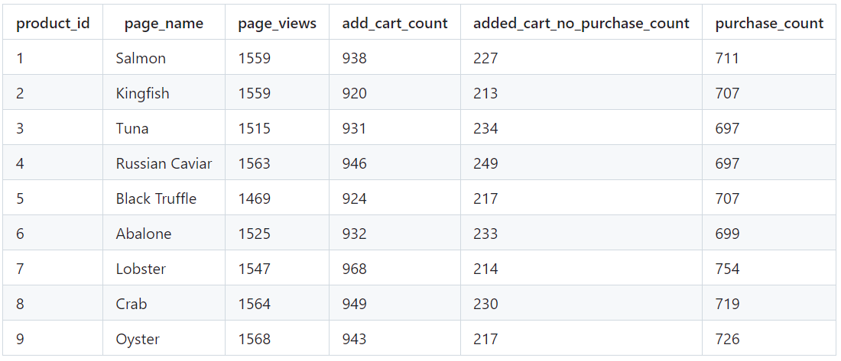

Slide 21
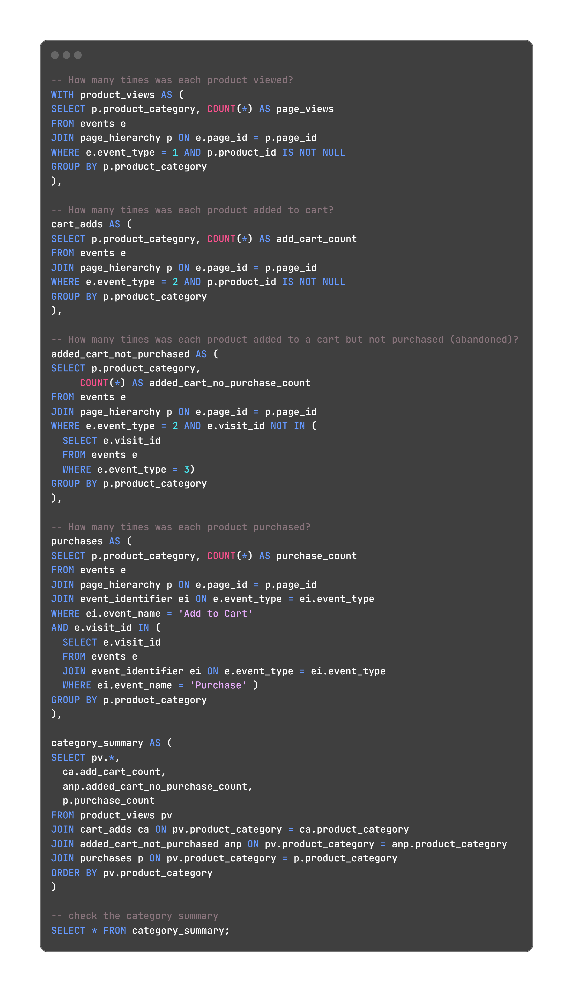
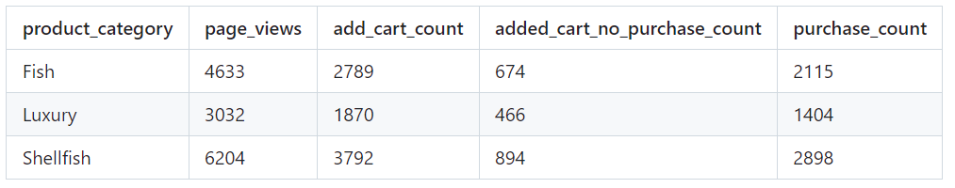

Slide 22
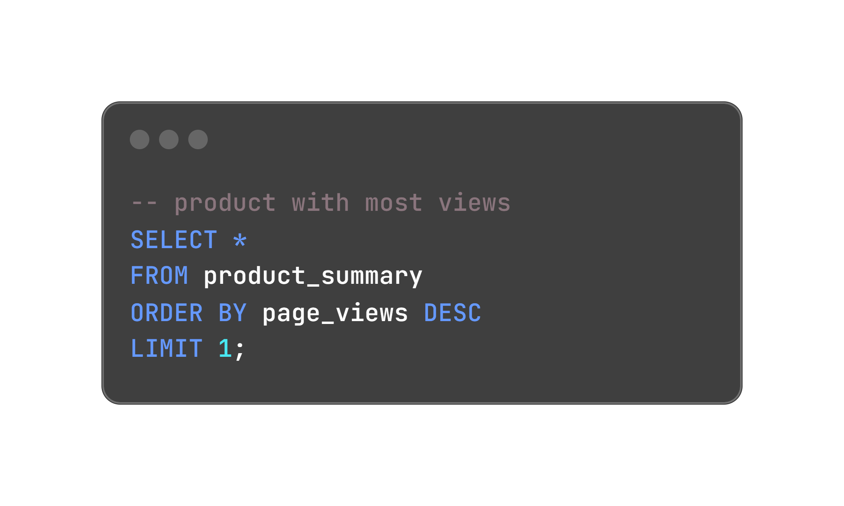

Slide 23
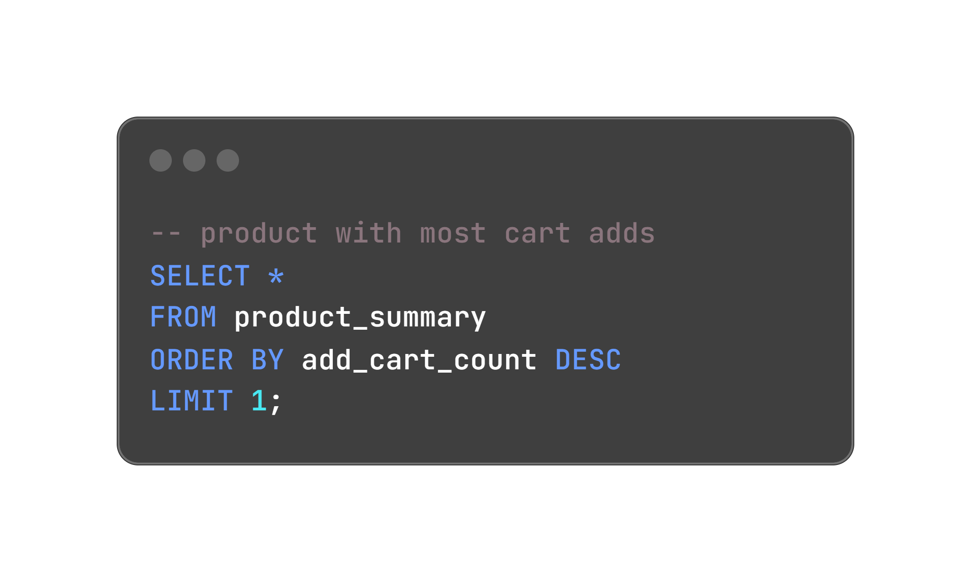

Slide 24


Slide 25
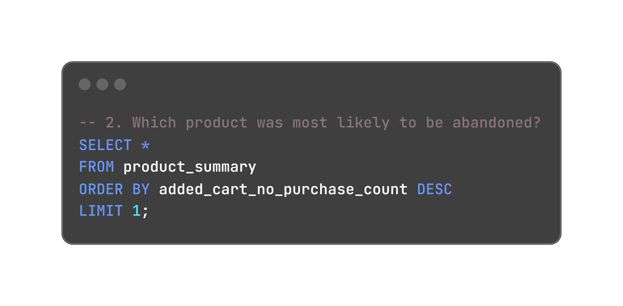

Slide 26
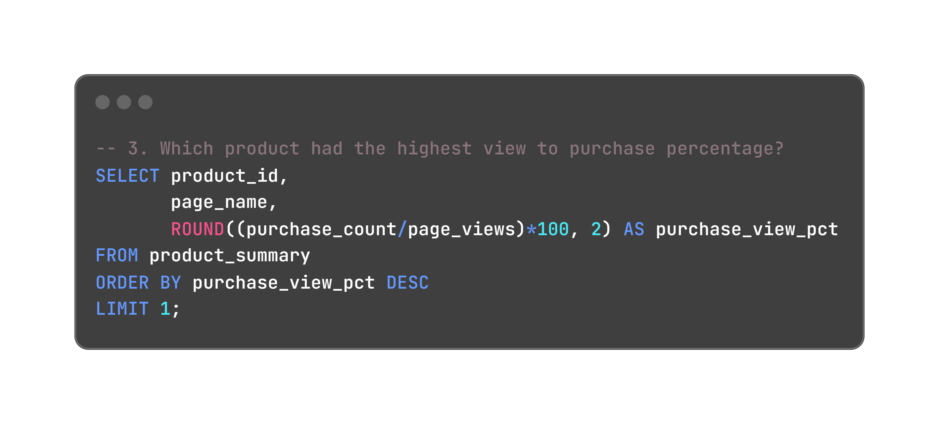
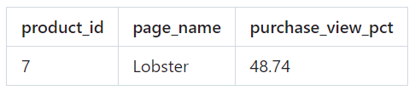

Slide 27
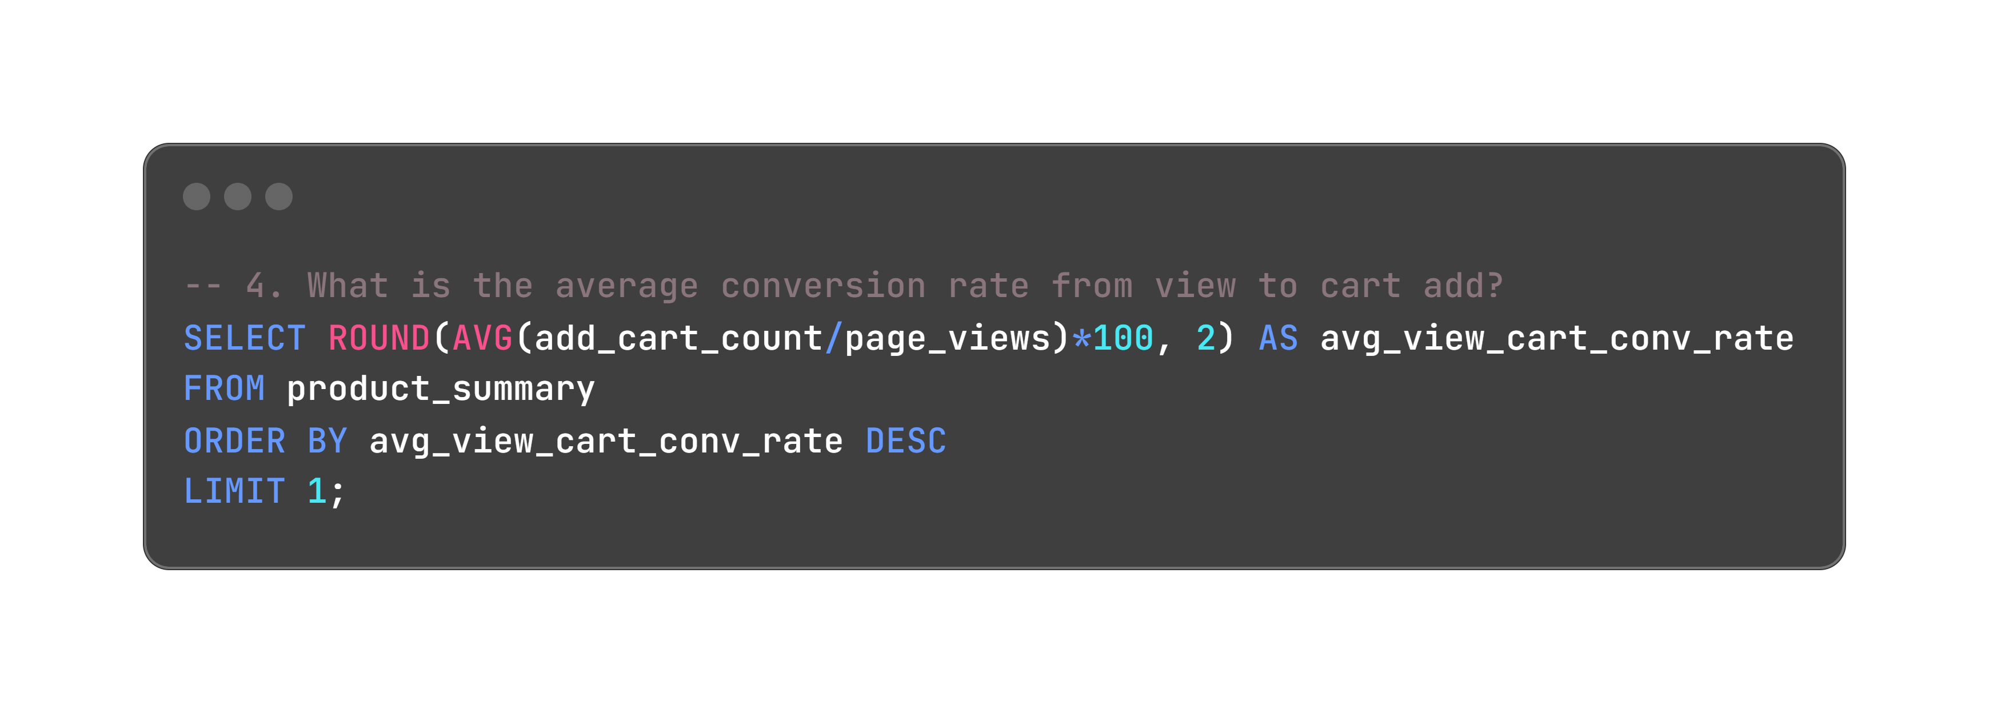
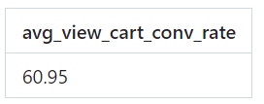

Slide 28
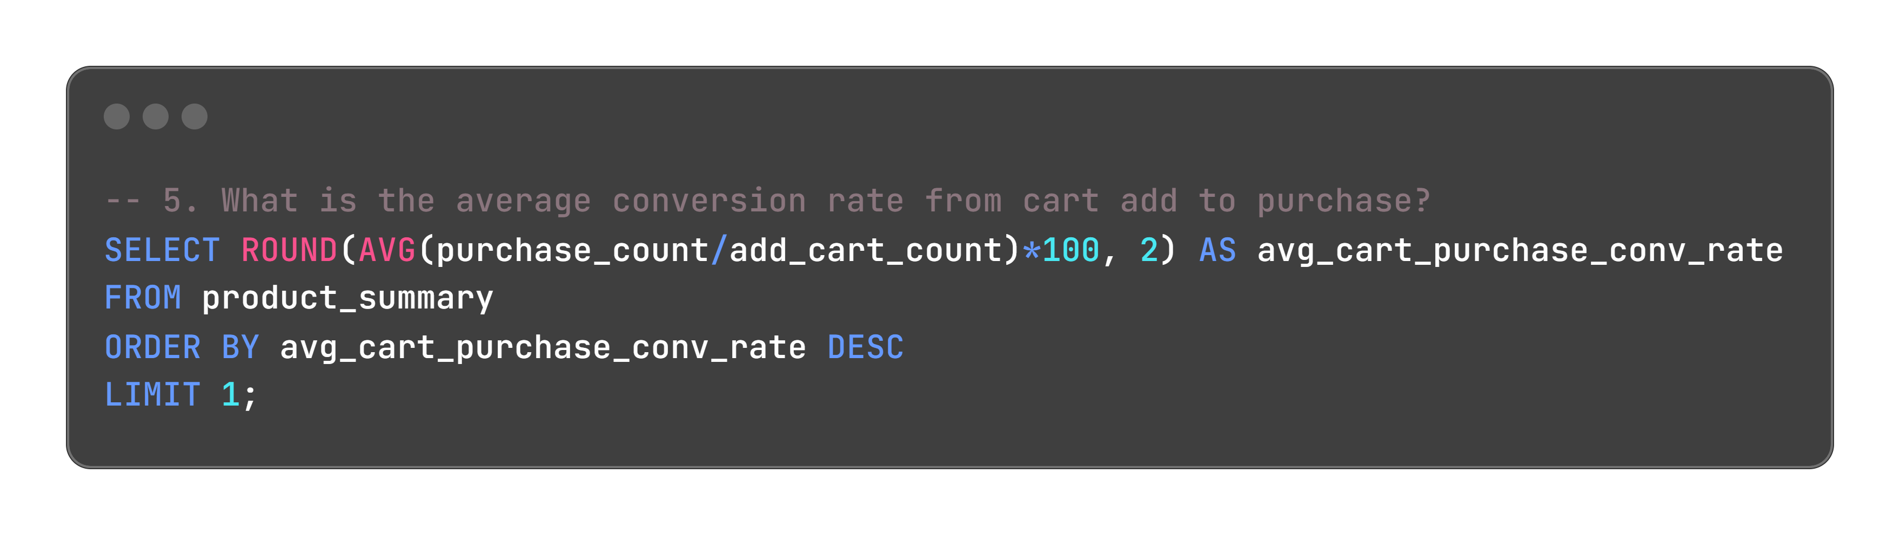
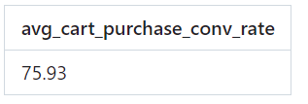

Slide 29
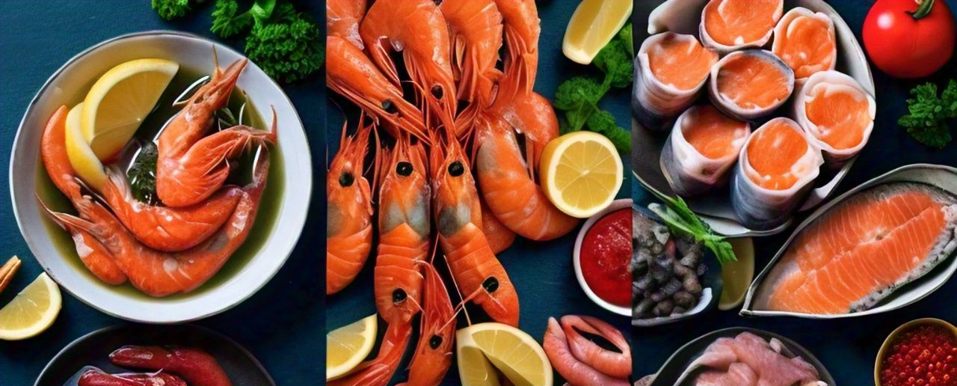
Campaigns Analysis

Slide 30
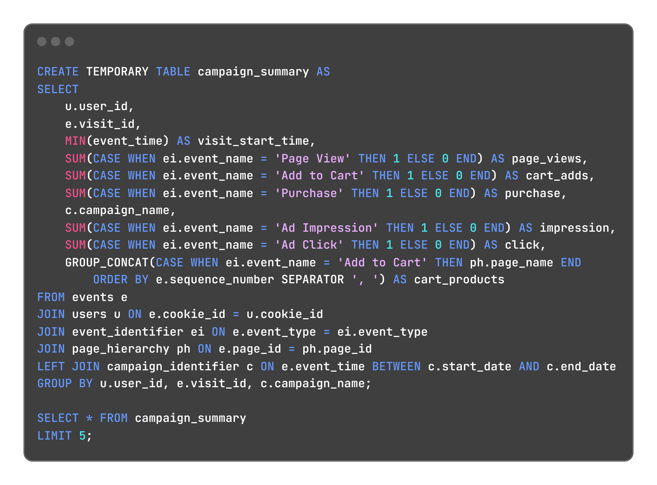

Slide 31
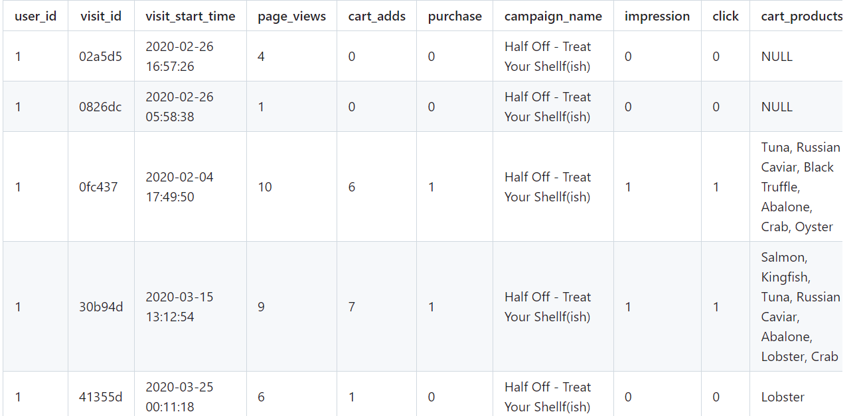

Slide 32
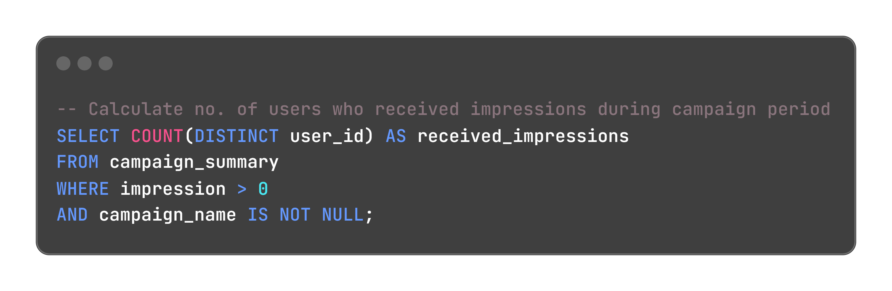
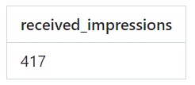

Slide 33
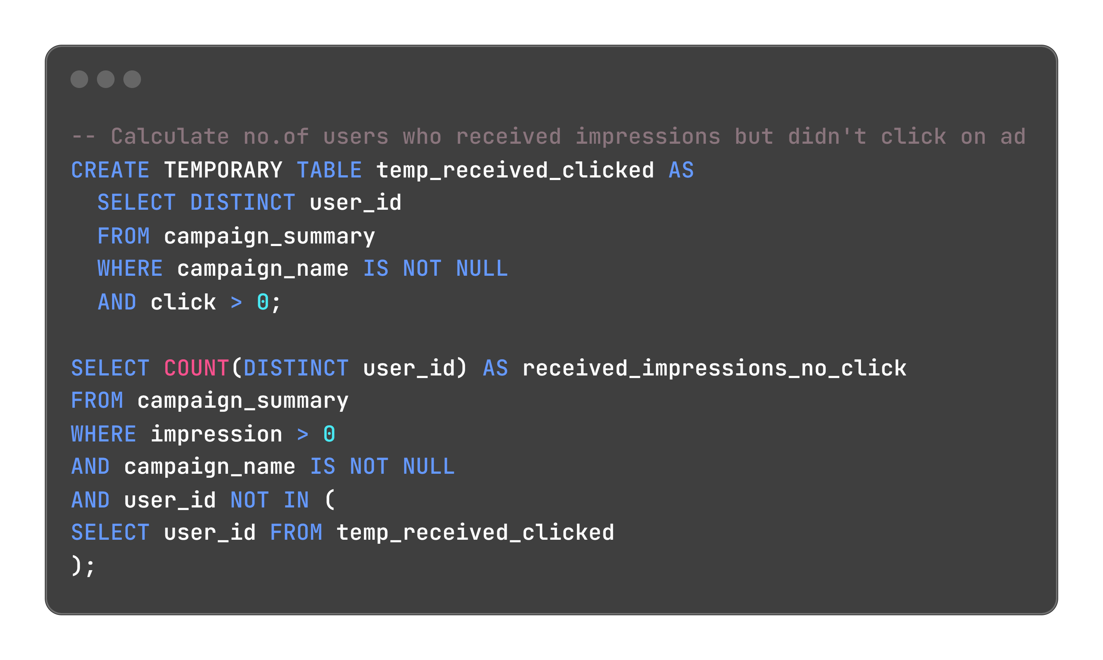
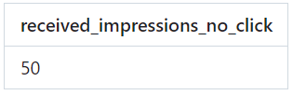

Slide 34
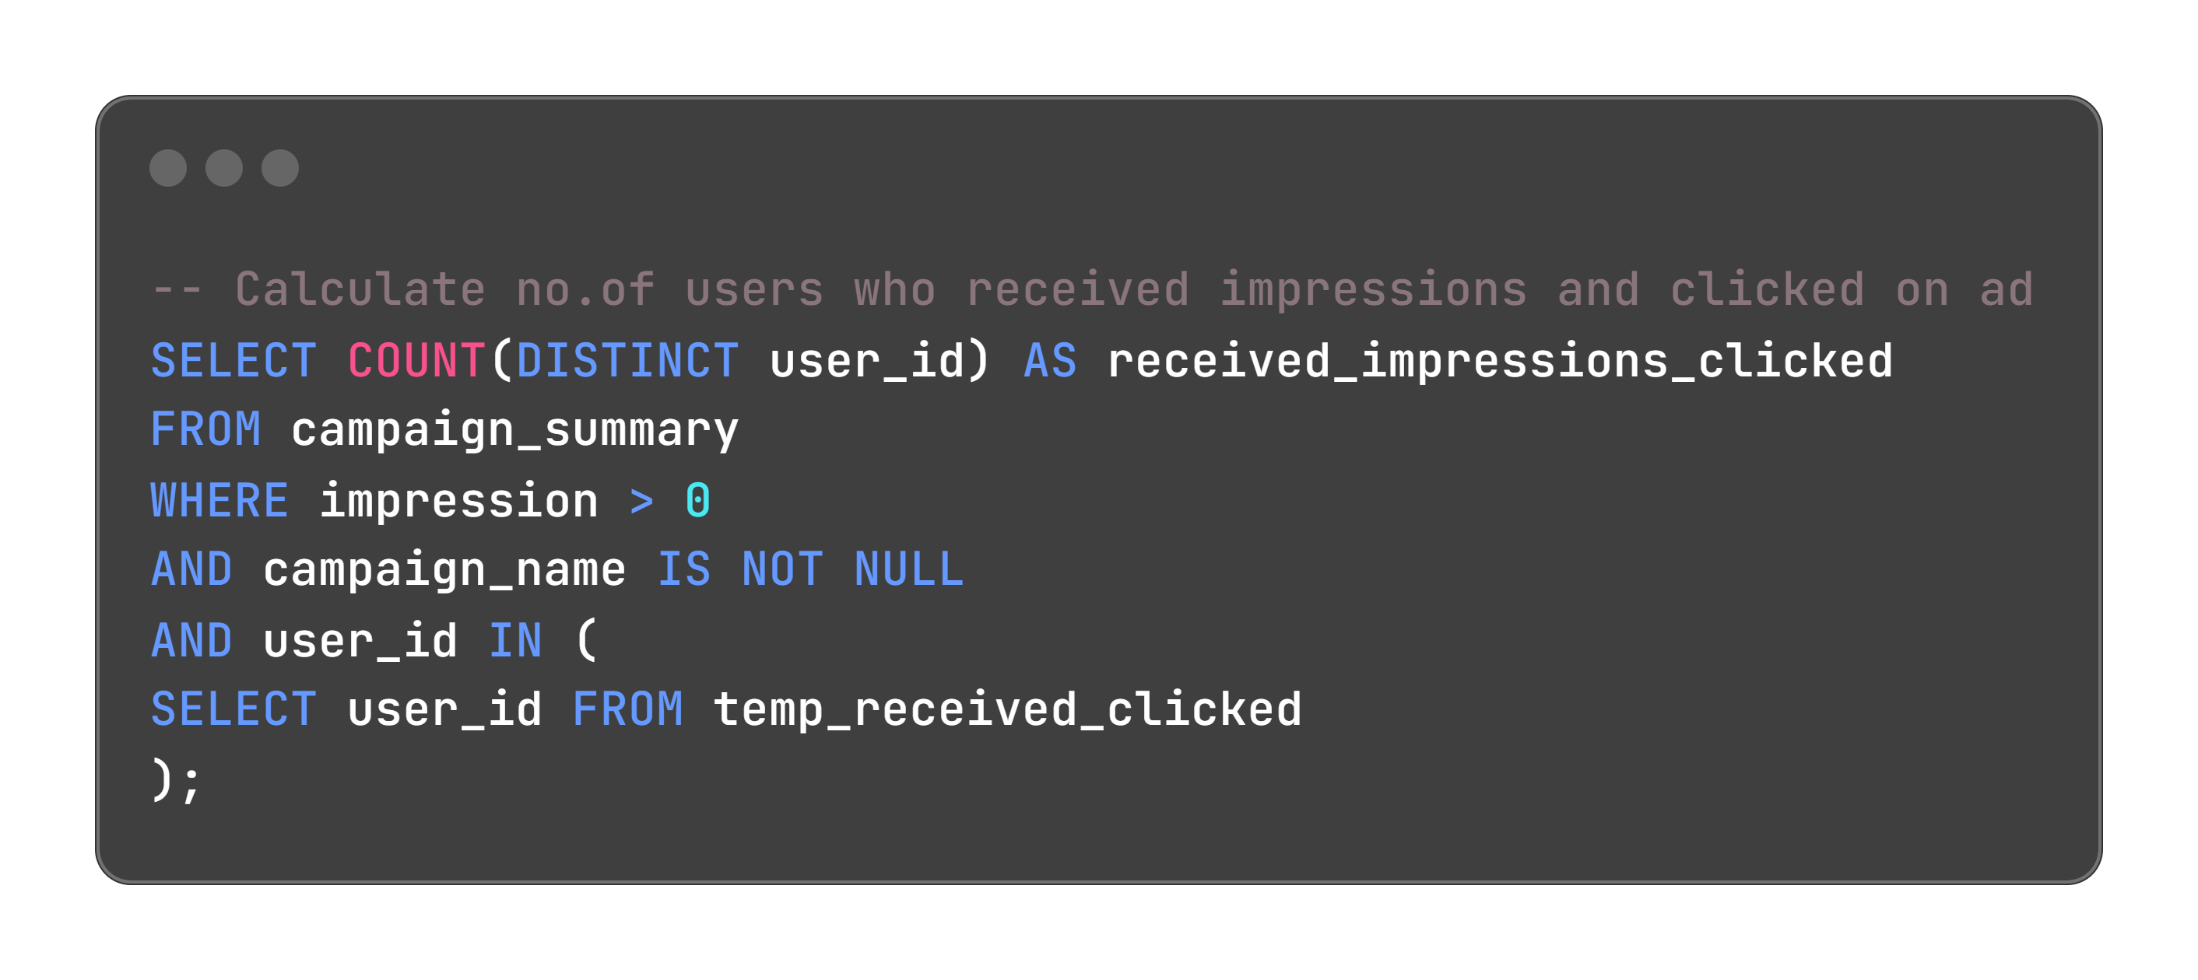
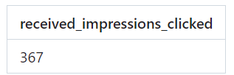

Slide 35
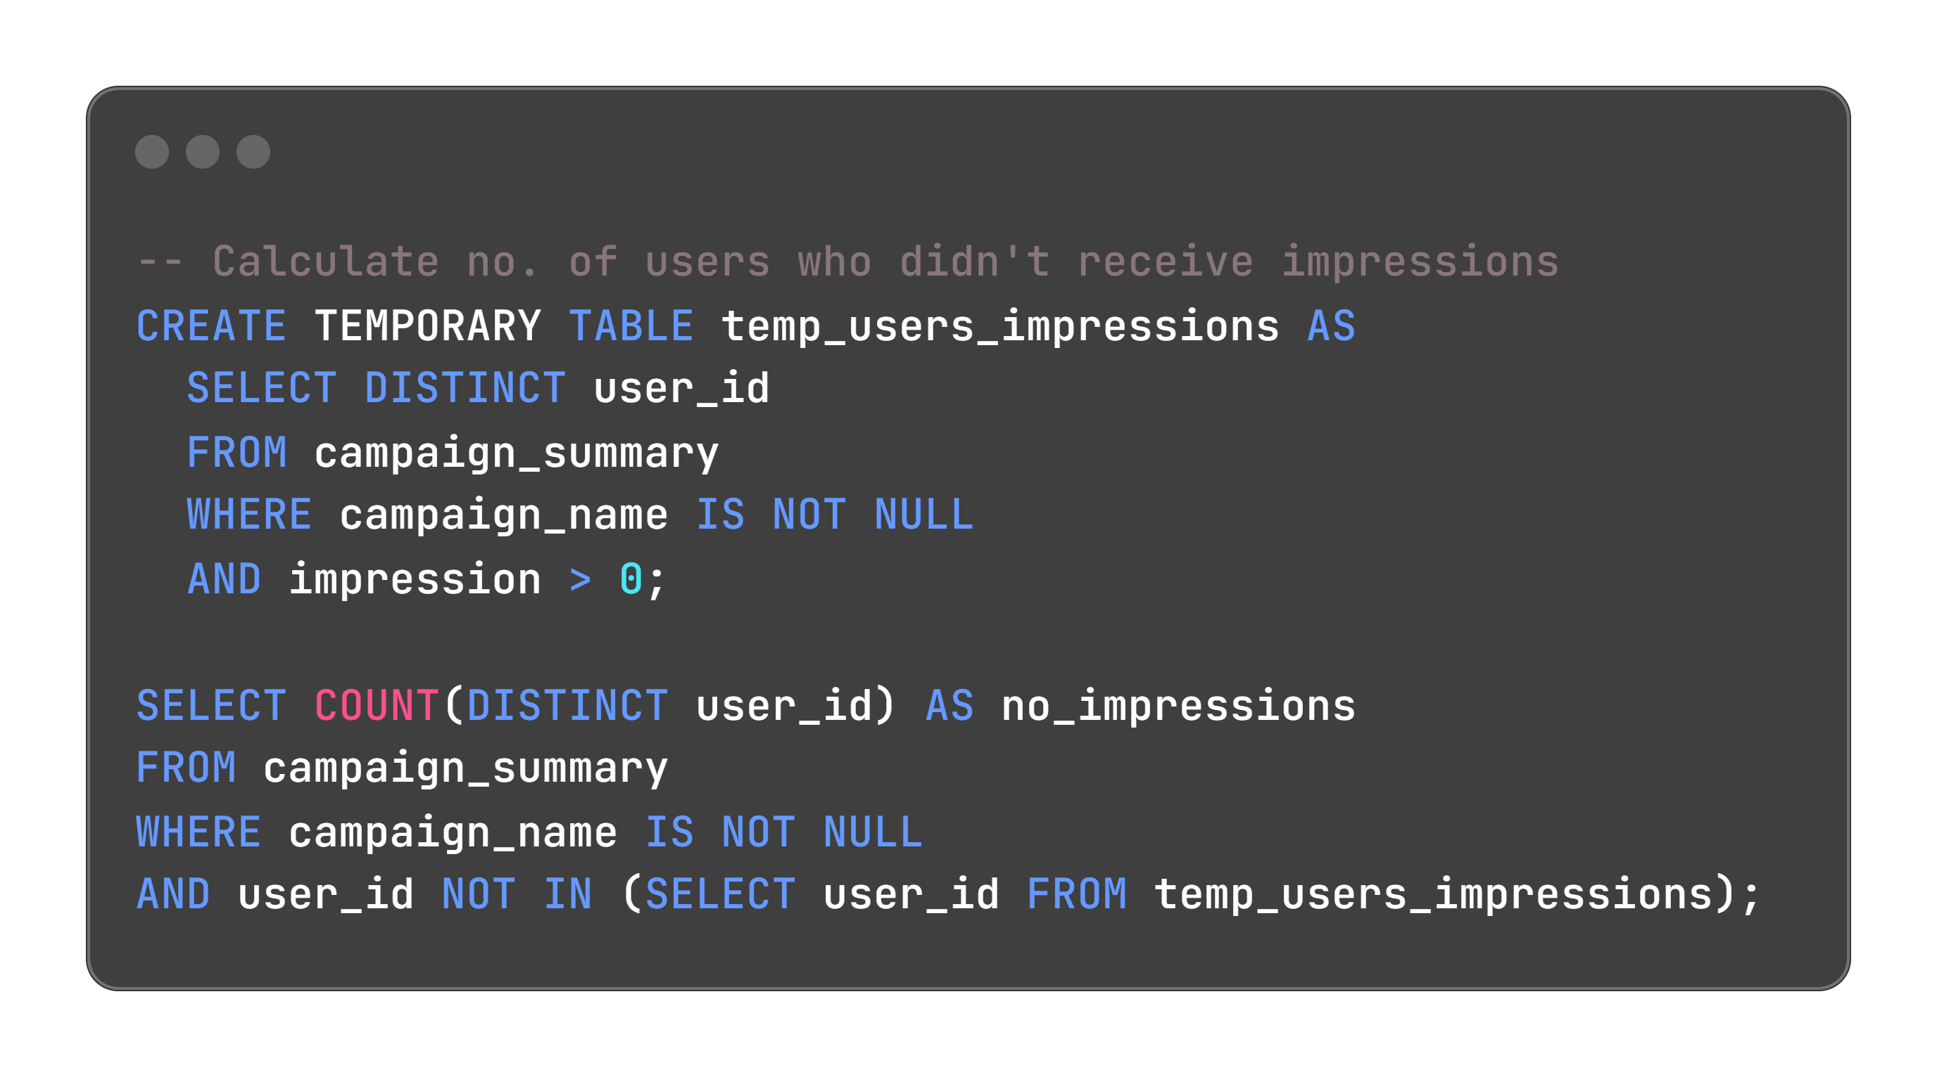


Slide 36
Observations
No.of users who received impressions during campaign period is 417
Among these users who received impressions, 50 users didn't click on the ad
No. of uses who received impressions and clicked on the ad is 367
No. of users who didn't receive impressions during campaign period is 78
Impression rate = No.of users who received impressions/Total users in the campaign period = (417/(417 + 78))*100 = 84.24%
Ad-click rate = No.of users who clicked the ad/No. of users who received impressions = (367/417)*100 = 88.01%

Slide 37



Slide 38



Slide 39



Slide 40



Slide 41
Insights
Average purchase of users who received impressions is 1.5
Average purchase of users who received impressions but didn't click on ad is 0.8
Average purchase of users who received impressions and clicked on ad is 1.6
Average purchase of users who didn't receive impressions is 1.3
Clicking on impressions lead to higher purchase rate (1.6 > 1.3)

Slide 42
Insights
Uplift in purchase rate when comparing users who click on a campaign impression vs. users who do not receive an impression
= ((1.6 - 1.3)/1.3)*100 = 23.08%
If we compare them with users who just got impression but do not click
= ((1.6 - 0.8)/0.8)*100 = 100%
Clicking on the ad leads to a 23.08% higher purchase rate compared to those who did not receive an impression.
Clicking on the ad leads to a 100% higher purchase rate compared to those who received an impression but didn't click.

Slide 43


The "Half Off - Treat Your Shellf(ish)" campaign performed the best across all metrics - highest page views, cart adds, and purchases - indicating that it was the most successful in driving both interest and conversions.

Slide 44



Slide 45
Insights & Recommendations
"Half Off - Treat Your Shellf(ish)" is the standout campaign in terms of total sales and reach, despite having a conversion rate similar to the other two campaigns.
The high conversion rates across all campaigns suggest that users who engage are highly likely to purchase, but the total impressions (reach) play a major role in determining overall success.
To improve the impact of campaigns like "Living The Lux Life" and "Fishing For Compliments", focusing on increasing impressions (i.e., expanding the audience) could lead to higher total purchases.

Slide 46



Slide 47
Insights & Recommendations
"BOGOF - Fishing For Compliments" is the most engaging campaign in terms of CTR, but due to the limited reach (fewer impressions), it generated fewer total clicks.
"Half Off - Treat Your Shellf(ish)" strikes a good balance between high CTR and larger reach, making it the overall winner in terms of driving clicks and engagement.
All campaigns have strong click-through rates, but increasing impressions for the campaigns with fewer clicks could improve their overall performance.

Slide 48
THANK YOU

